Slide 1
EEE 2113 Electrical Circuits Basic Concepts
Prepared by
Lec Saifur Rahman
Email: saifur@cse.uiu.ac.bd
Moblie: 01303529289

Slide 2
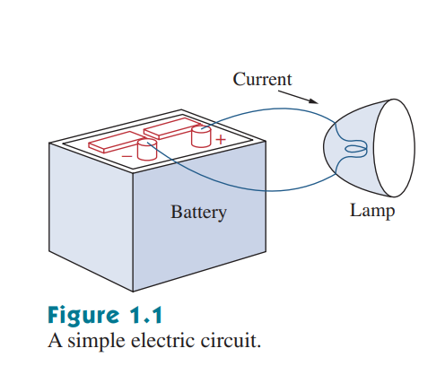
Electric Circuit
An electric circuit is an interconnection of electrical elements

Slide 3
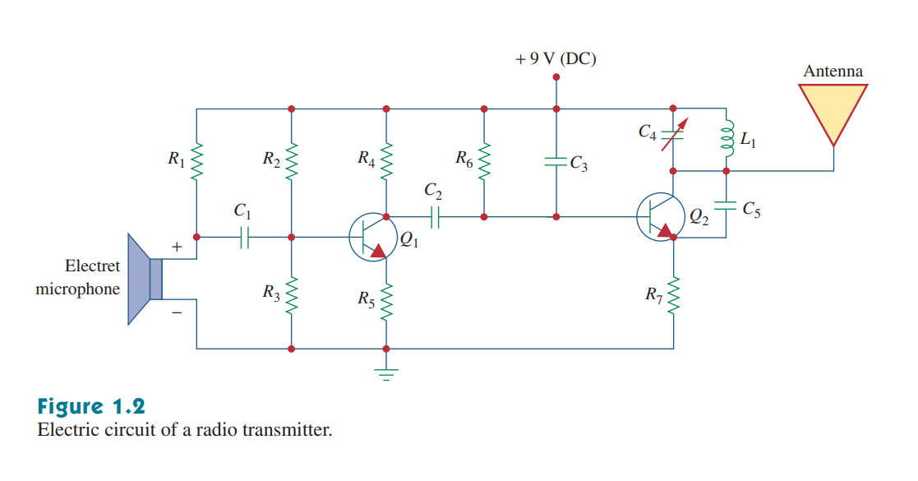
Electrical Circuit
A real-life electrical circuit consists of various components

Slide 4
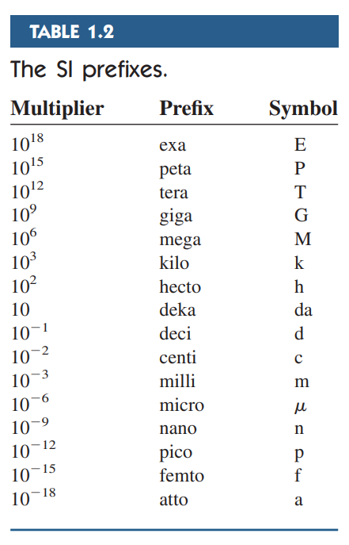
System of Units

Slide 5

Electrical Charge
Charge is an electrical property of the atomic particles of which matter consists, measured in coulombs (C).

Slide 6
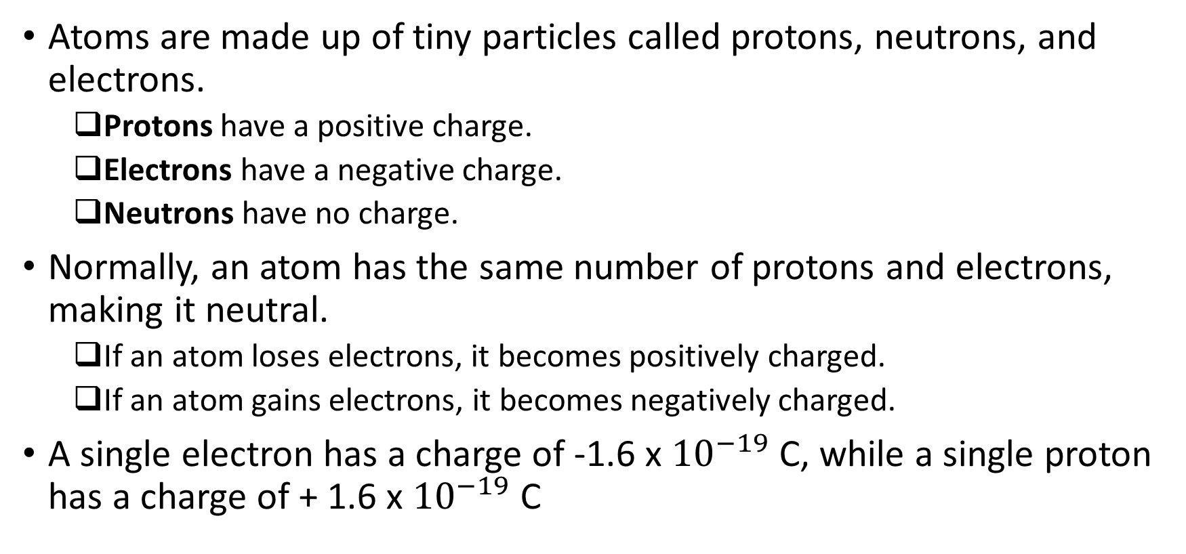
Electrical Charge
Atoms are made up of tiny particles called protons, neutrons, and electrons.
Protons have a positive charge.
Electrons have a negative charge.
Neutrons have no charge.
Normally, an atom has the same number of protons and electrons, making it neutral.
If an atom loses electrons, it becomes positively charged.
If an atom gains electrons, it becomes negatively charged.
A single electron has a charge of -1.6 x ${10}^{−19}$ C, while a single proton has a charge of + 1.6 x ${10}^{−19}$ C

Slide 7
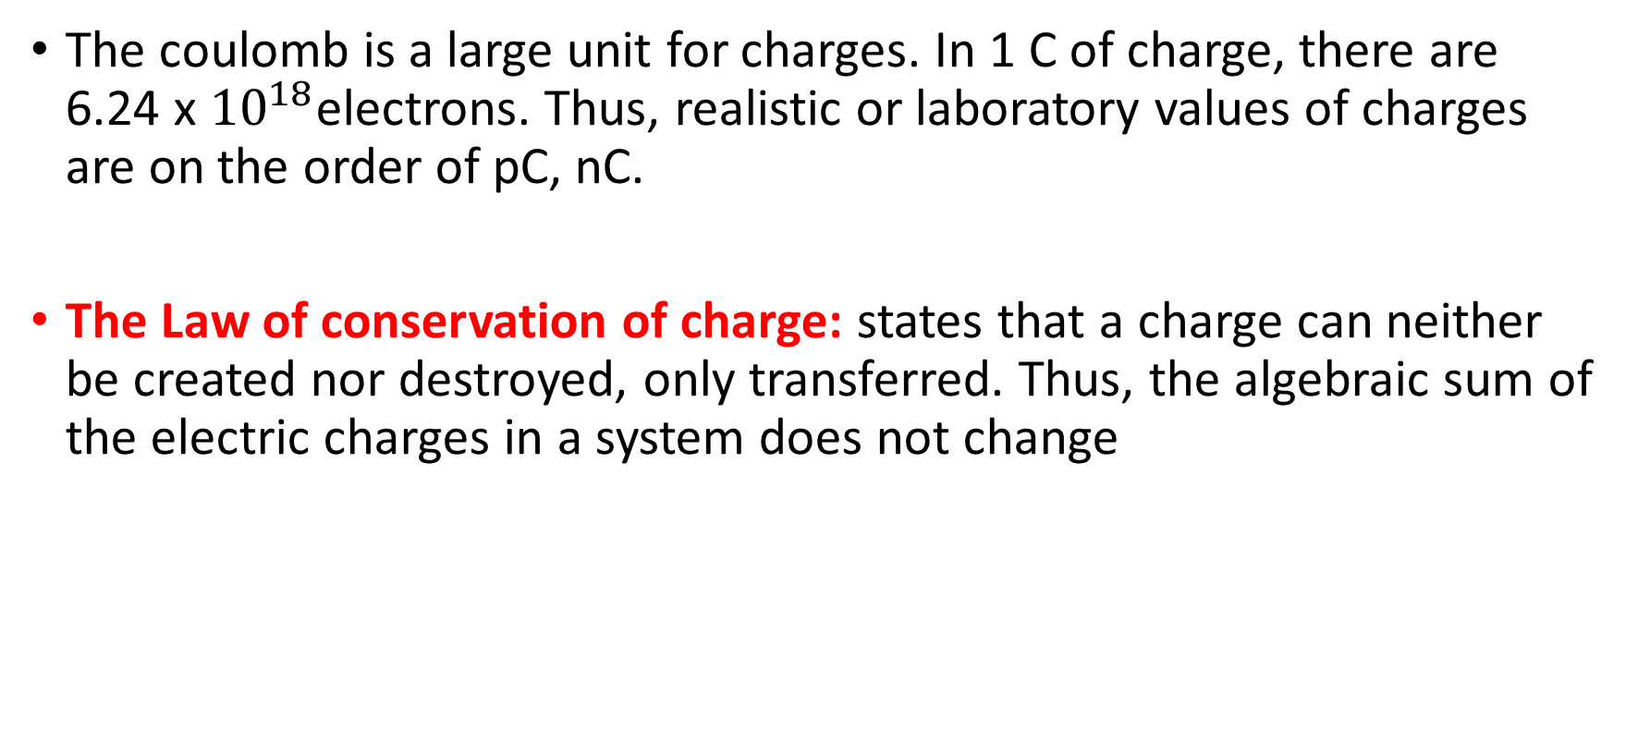
Electrical Charge
The coulomb is a large unit for charges. In 1 C of charge, there are 6.24 x ${10}^{18}$electrons. Thus, realistic or laboratory values of charges are on the order of pC, nC.
The Law of conservation of charge: states that a charge can neither be created nor destroyed, only transferred. Thus, the algebraic sum of the electric charges in a system does not change

Slide 8
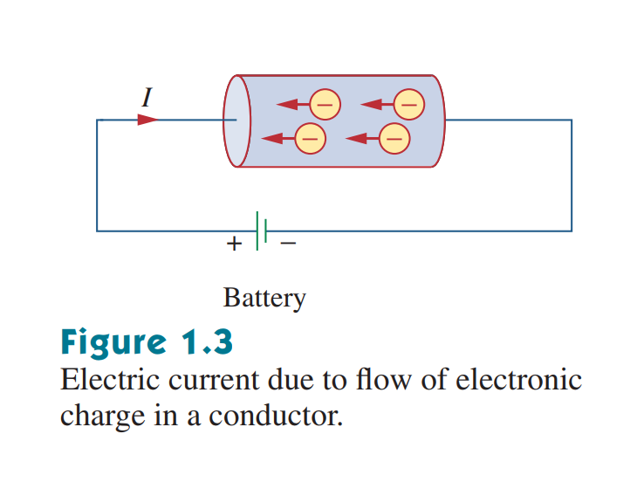
Flow of Charges
In electrical circuits, we are concerned with the charges that can freely move or flow
When we apply an electromotive force (emf) on charges, they gain energy, and start moving
Emf is also known as voltage or potential difference
Notes:
Direction of flow of current vs flow of electrons is opposite. We follow conventional direction of current.

Slide 9
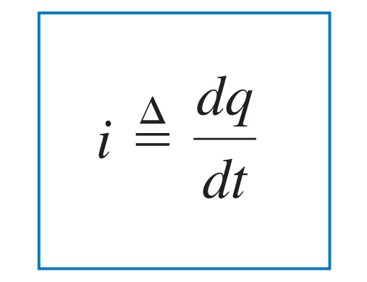
Electric Current
Electric current is the time rate of change of charge, measured in amperes (A).
Mathematically, the relationship between current i, charge q, and time t is
where current is measured in amperes (A), and 1 A = 1C/s

Slide 10
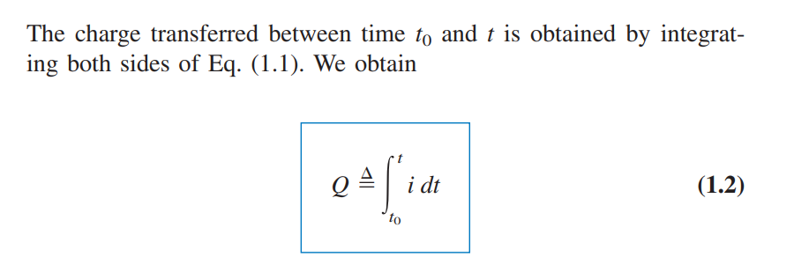
Quantifying Electrical Charge
Notes:
Charge and current not constant and can change with time. The classic physics formula we studied comes if we consider current to be constant.

Slide 11
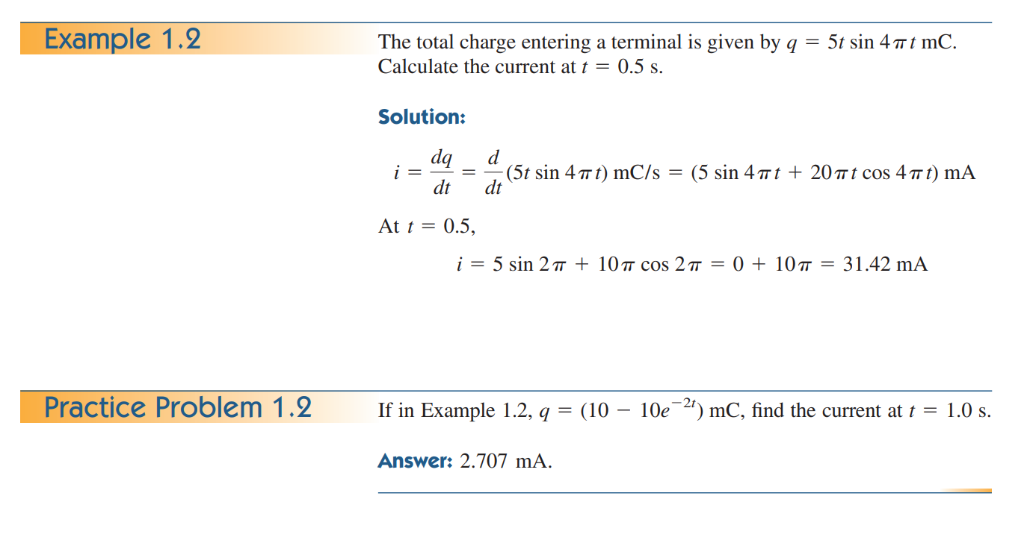

Slide 12
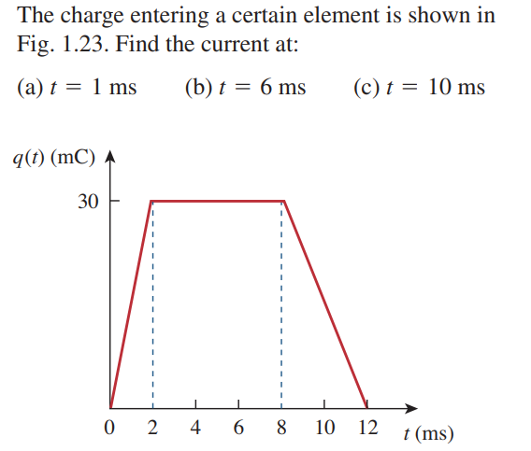
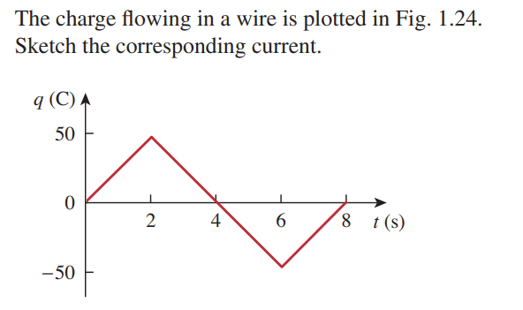
Math Problem Practice:

Slide 13
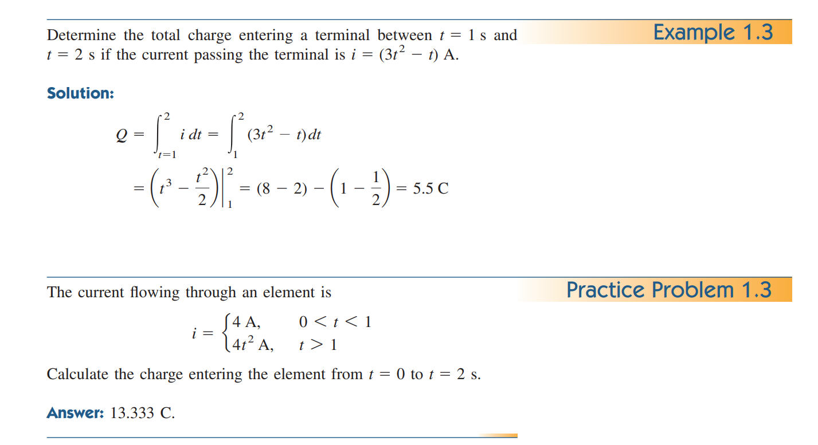

Slide 14
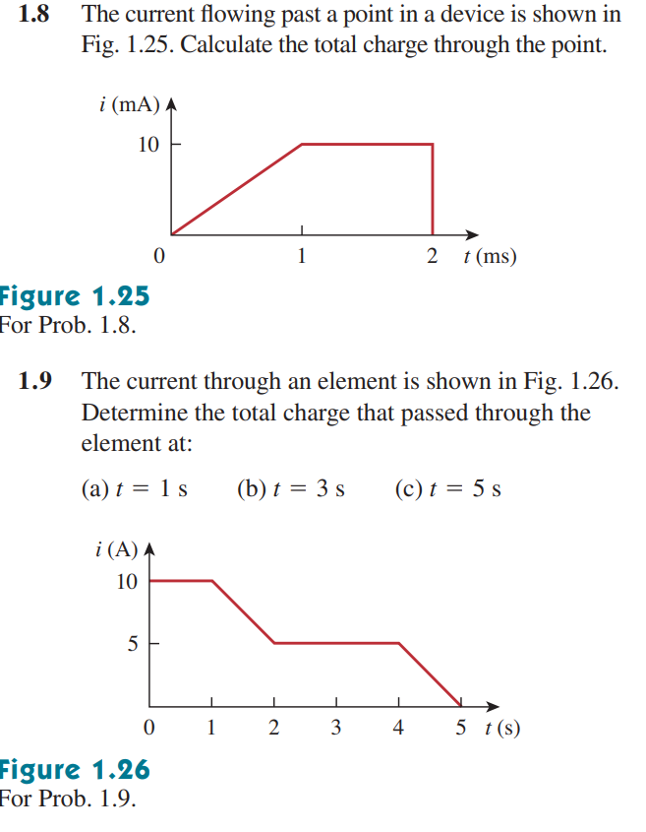
Math Problem Practice:

Slide 15

Voltage
To move the electron in a conductor in a particular direction requires some work or energy transfer.
This work is performed by an external electromotive force (emf), typically represented by the battery.
The voltage between two points a and b in an electric circuit is the energy (or work) needed to move a unit charge from a to b

Slide 16
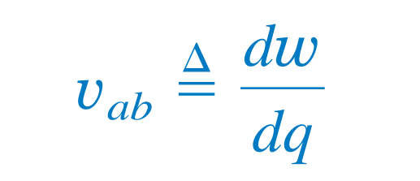
Voltage
Voltage (or potential difference) is the energy required to move a unit charge through an element, measured in volts (V).
1 V = 1 J/C

Slide 17
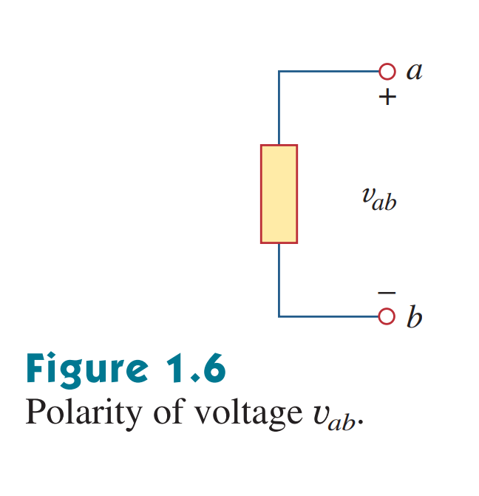
Polarity of voltage
Voltage arises due to the difference in electric potential between two points in a circuit.
The point which has a higher potential is given a ‘+’ polarity, while the point which is at a lower potential is given a ‘-’ polarity
v_{ab} = -v_{ba}

Slide 18
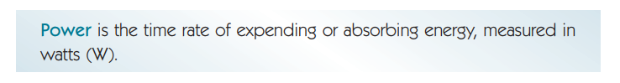
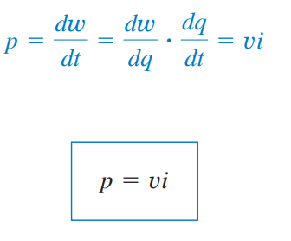
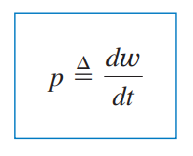
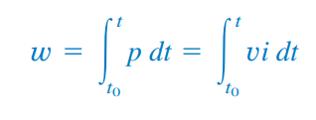
Electrical Power and Energy

Slide 19
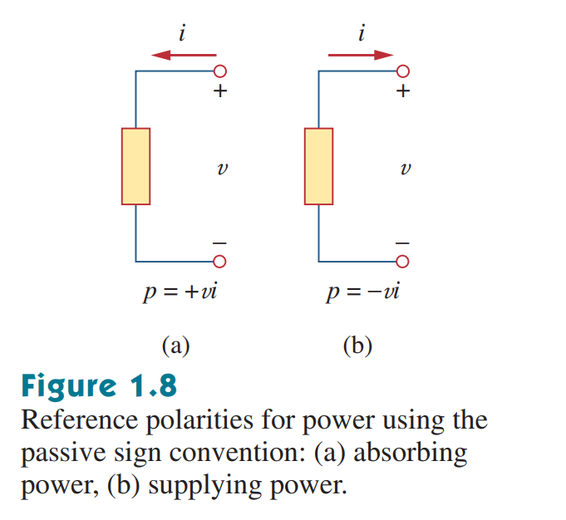
Sign Convention for Power
If current is entering through the positive terminal of a component, we give it a positive sign
A positive power indicates power absorbed by the component
If current is entering through the negative terminal of a component, we give it a negative sign
A negative power indicates power supplied by the component
In an electric circuit,
total power supplied = -total power absorbed
Notes:
Show a basic circuit

Slide 20
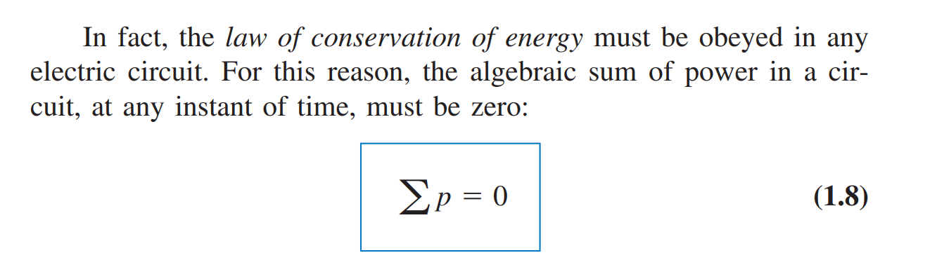
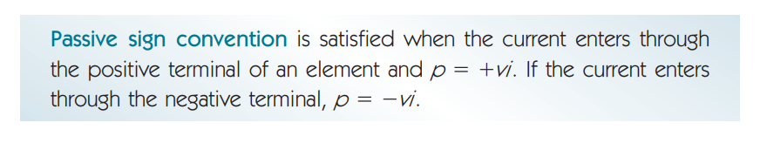
Law of Conservation of Energy in Circuits

Slide 21
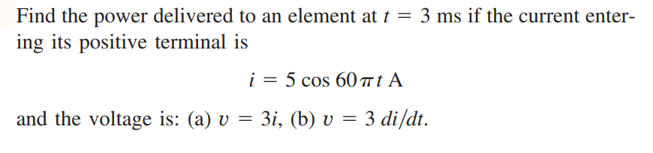
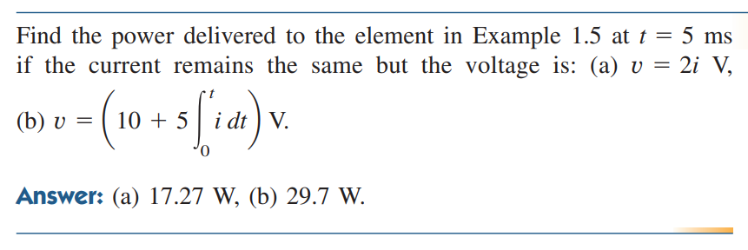
Math Problem Practice:

Slide 22
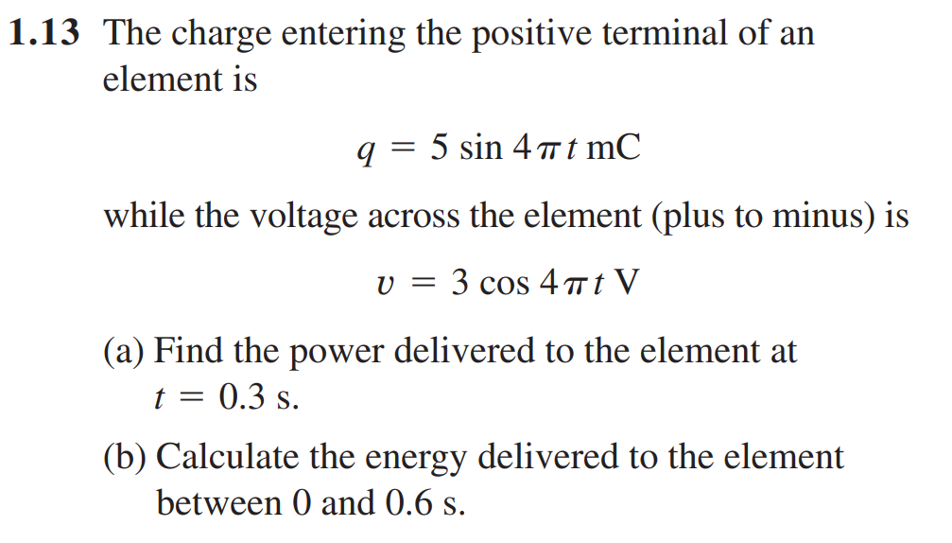

Math Problem Practice:
Ans:

Slide 23
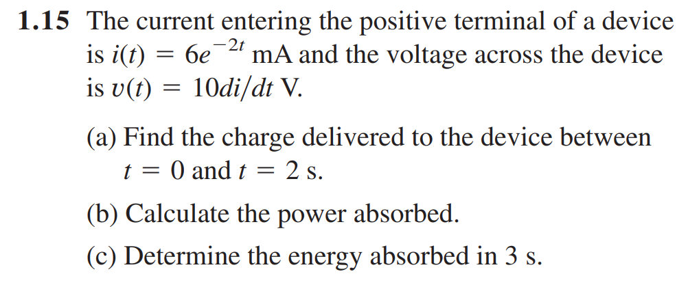
Math Problem Practice:
Ans:

Slide 24
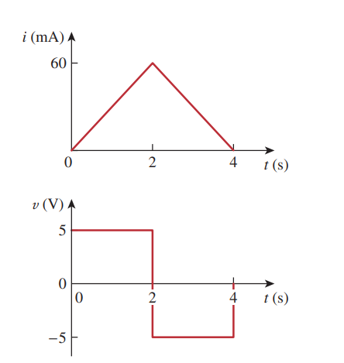
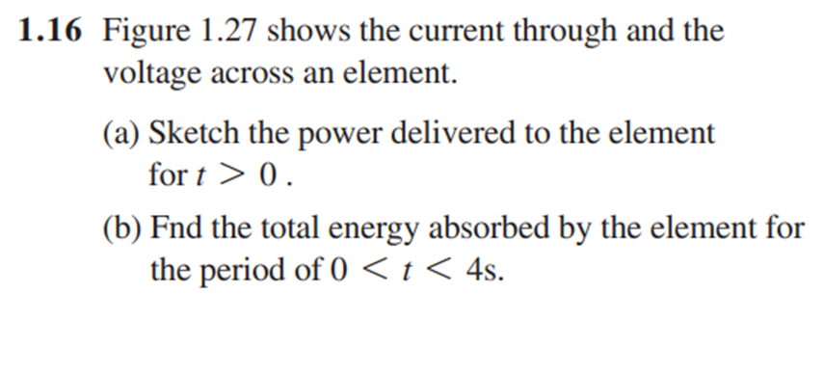
Math Problem Practice:

